Slide 1
Brushless DC motor (BLDC)

Slide 2
What is a Brushless DC motor (BLDC)?
A brushless DC motor (known as BLDC) is a permanent magnet synchronous electric motor which is driven by direct current (DC) electricity and it accomplishes electronically controlled commutation system (commutation is the process of producing rotational torque in the motor by changing phase currents through it at appropriate times) instead of a mechanically commutation system. BLDC motors are also referred as trapezoidal permanent magnet motors.

Slide 3
Unlike conventional brushed type DC motor, wherein the brushes make the mechanical contact with commutator on the rotor so as to form an electric path between a DC electric source and rotor armature windings, BLDC motor employs electrical commutation with permanent magnet rotor and a stator with a sequence of coils. In this motor, permanent magnet (or field poles) rotates and current carrying conductors are fixed.

Slide 4
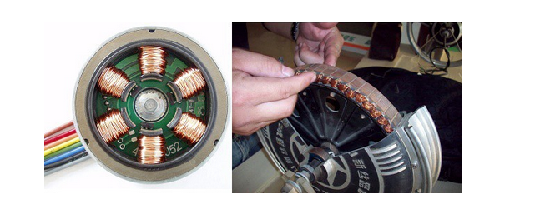

Slide 5
The armature coils are switched electronically by transistors or silicon controlled rectifiers at the correct rotor position in such a way that armature field is in space quadrature with the rotor field poles. Hence the force acting on the rotor causes it to rotate. Hall sensors or rotary encoders are most commonly used to sense the position of the rotor and are positioned around the stator. The rotor position feedback from the sensor helps to determine when to switch the armature current.

Slide 6
This electronic commutation arrangement eliminates the commutator arrangement and brushes in a DC motor and hence more reliable and less noisy operation is achieved. Due to the absence of brushes BLDC motors are capable to run at high speeds. The efficiency of BLDC motors is typically 85 to 90 percent, whereas as brushed type DC motors are 75 to 80 percent efficient. There are wide varieties of BLDC motors available ranging from small power range to fractional horsepower, integral horsepower and large power ranges

Slide 7
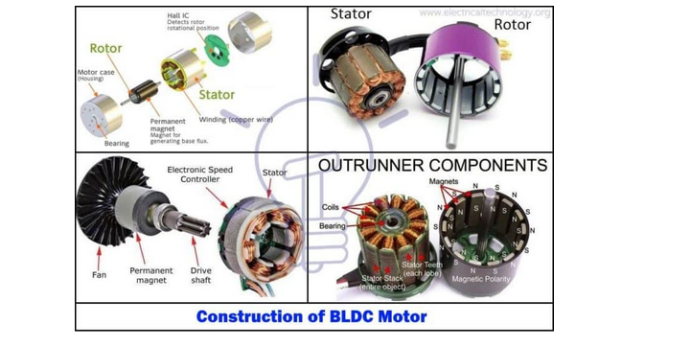
Construction of BLDC Motor

Slide 8
BLDC motors can be constructed in different physical configurations. Depending on the stator windings, these can be configured as single-phase, two-phase, or three-phase motors. However, three-phase BLDC motors with permanent magnet rotor are most commonly used.

Slide 9
The construction of this motor has many similarities of three phase induction motor as well as conventional DC motor. This motor has stator and rotor parts as like all other motors.

Slide 10
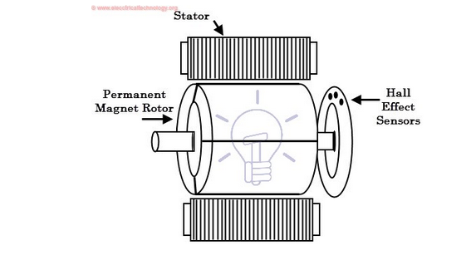

Slide 11
Stator
Stator of a BLDC motor made up of stacked steel laminations to carry the windings. These windings are placed in slots which are axially cut along the inner periphery of the stator. These windings can be arranged in either star or delta. However, most BLDC motors have three phase star connected stator.
Each winding is constructed with numerous interconnected coils, where one or more coils are placed in each slot. In order to form an even number of poles, each of these windings is distributed over the stator periphery.

Slide 12
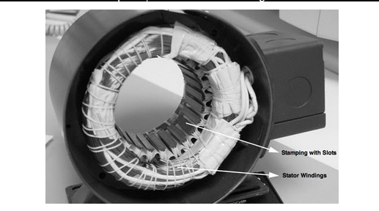

Slide 13
The stator must be chosen with the correct rating of the voltage depending on the power supply capability. For robotics, automotive and small actuating applications, 48 V or less voltage BLDC motors are preferred. For industrial applications and automation systems, 100 V or higher rating motors are used.

Slide 14
Rotor
BLDC motor incorporates a permanent magnet in the rotor. The number of poles in the rotor can vary from 2 to 8 pole pairs with alternate south and north poles depending on the application requirement.
In order to achieve maximum torque in the motor, the flux density of the material should be high.
A proper magnetic material for the rotor is needed to produce required magnetic field density.

Slide 15
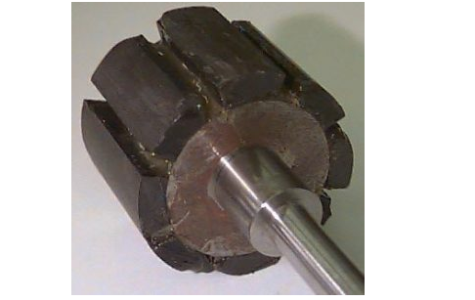

Slide 16
Ferrite magnets are inexpensive, however they have a low flux density for a given volume. Rare earth alloy magnets are commonly used for new designs. Some of these alloys are Samarium Cobalt (SmCo), Neodymium (Nd), and Ferrite and Boron (NdFeB). The rotor can be constructed with different core configurations such as the circular core with permanent magnet on the periphery, circular core with rectangular magnets, etc.

Slide 17
Hall Sensors
Hall sensor provides the information to synchronize stator armature excitation with rotor position.
Since the commutation of BLDC motor is controlled electronically, the stator windings should be energized in sequence in order to rotate the motor.
Before energizing a particular stator winding, acknowledgment of rotor position is necessary. So the Hall Effect sensor embedded in stator senses the rotor position.

Slide 18
Most BLDC motors incorporate three Hall sensors which are embedded into the stator. Each sensor generates Low and High signals whenever the rotor poles pass near to it.
The exact commutation sequence to the stator winding can be determined based on the combination of these three sensor’s response

Slide 19
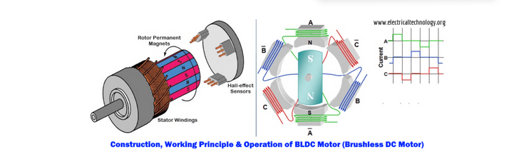
Working Principle and Operation of BLDC Motor

Slide 20
BLDC motor works on the principle similar to that of a conventional DC motor, i.e., the Lorentz force law which states that whenever a current carrying conductor placed in a magnetic field it experiences a force.
As a consequence of reaction force, the magnet will experience an equal and opposite force. In case BLDC motor, the current carrying conductor is stationary while the permanent magnet moves.

Slide 21
When the stator coils are electrically switched by a supply source, it becomes electromagnet and starts producing the uniform field in the air gap.
Though the source of supply is DC, switching makes to generate an AC voltage waveform with trapezoidal shape.
Due to the force of interaction between electromagnet stator and permanent magnet rotor, the rotor continues to rotate.

Slide 22
Observe that motor produces torque because of the development of attraction forces (when North-South or South-North alignment) and repulsion forces (when North-North or South-South alignment). By this way motor moves in a clockwise direction.

Slide 23
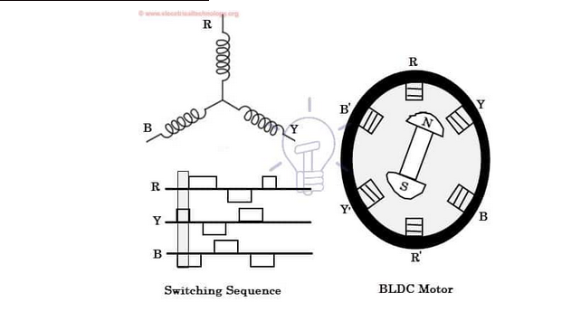

Slide 24
Here, one might get a question that how we know which stator coil should be energized and when to do. This is because; the motor continuous rotation depends on the switching sequence around the coils. As discussed above that Hall sensors give shaft position feedback to the electronic controller unit.
Based on this signal from sensor, the controller decides particular coils to energize. Hall-effect sensors generate Low and High level signals whenever rotor poles pass near to it. These signals determine the position of the shaft.

Slide 25
Brushless DC Motor Drive
As described above that the electronic controller circuit energizes appropriate motor winding by turning transistor or other solid state switches to rotate the motor continuously. The figure below shows the simple BLDC motor drive circuit which consists of MOSFET bridge (also called as inverter bridge), electronic controller, hall effect sensor and BLDC motor.
Here, Hall-effect sensors are used for position and speed feedback. The electronic controller can be a microcontroller unit or microprocessor or DSP processor or FPGA unit or any other controller. This controller receives these signals, processes them and sends the control signals to the MOSFET driver circuit.

Slide 26
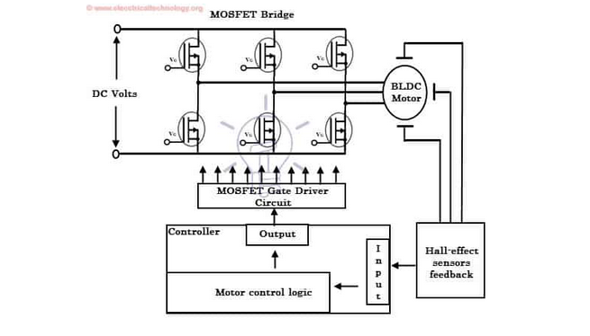

Slide 27
Advantages of BLDC Motor
It has no mechanical commutator and associated problems
High efficiency due to the use of permanent magnet rotor
High speed of operation even in loaded and unloaded conditions due to the absence of brushes that limits the speed
Smaller motor geometry and lighter in weight than both brushed type DC and induction AC motors
Long life as no inspection and maintenance is required for commutator system
Higher dynamic response due to low inertia and carrying windings in the stator
Less electromagnetic interference
Quite operation (or low noise) due to absence of brushes

Slide 28
Disadvantages of Brushless Motor
These motors are costly
Electronic controller required control this motor is expensive
Not much availability of many integrated electronic control solutions, especially for tiny BLDC motors
Requires complex drive circuitry
Need of additional sensors

Slide 29
Applications of Brushless DC Motors (BLDC)
Brushless DC Motors (BLDC) are used for a wide variety of application requirements such as varying loads, constant loads and positioning applications in the fields of industrial control, automotive, aviation, automation systems, health care equipments, etc. Some specific applications of BLDC motors are

Slide 30
Computer hard drives and DVD/CD players
Electric vehicles, hybrid vehicles, and electric bicycles
Industrial robots, CNC machine tools, and simple belt driven systems
Washing machines, compressors and dryers
Fans, pumps and blowers

